Slide 1
Intake/Interview Form, Screening & Interviewing Taxpayer
Form 13614-C Intake/Interview Form
Adapted from NTTC TY2013 – Module 02 Screening and Interviewing
Notes:
This is the beginning of the journey to prepare an accurate, in-scope tax return
A short lesson, but very important to set the stage for probably the most important aspect of being an effective Counselor at the tax site

Slide 2
Objectives
Understanding how IntakeInterview Sheet (Form 13614-C) should be completed
Conducting an effective screening & interview with taxpayer to confirm and correct information on Intake Sheet
Using various communication techniques to probe and secure information to prepare a complete and accurate return
Notes:
Advise students what they learn in this lesson will be applied throughout the course

Slide 3
Engage the Taxpayer
Put the taxpayer at ease
Be positive and friendly – build rapport
Introduce yourself with a smile and a handshake
Engage in small talk
Explain process to taxpayer
Especially important for first-time clients
Notes:
Remember – for some this will be a difficult, trying experience
Giving their personal confidential information to a stranger
Will they owe more than they can afford
Will they get the refund they hope for
May have physical limitations

Slide 4
Overall Process Explain What Taxpayer Should Expect
Client assignment, and appointment scheduling processes vary across sites.
Once the client is on site, the process will consist of:
Client completion of the Intake/Interview Sheet (Form 13614-C Pages 1 - 3)
Note: Counselor identifies Out of Scope and “For Experienced Counselor” items
Review of taxpayer’s situation; last year’s return, Intake/Interview Sheet, documents, etc.
Electronic preparation of the return
Review by second counselor (Quality Review)
Printing and review of tax return with client
Wrap-up: signatures on Form 8879, papers organized, etc.
Return will be e-filed expeditiously
Notes:
Make sure taxpayer understands the steps you will follow that lead to his/her return being completed
Review Intake/Interview sheet and documents and last year’s return to make sure you have everything and return is in scope
Data entry in TaxWise – will likely have questions as you go through this
Your review of completed return with taxpayer – he/she knows better than anyone if spellings are correct, addresses correct, etc. plus chance to answer any questions
QR by a second set of eyes to make sure everything is correct
Will give copies of returns to taxpayer for their records
Will e-file Federal and state returns (unless there is a tax law related reason not to – we don’t prepare paper returns otherwise)
Will give them any paper returns to mail if necessary

Slide 5
IRS Intake/Interview Form – Form 13614-C
(cont’d)
A Four-Page Form:
Page 1: Part I-Personal Info *
Part II-Marital Status & Household Info *
Page 2: Part III-Income *
Part IV-Expenses *
Part V-Life Events *
Page 3: Part VI-Health Care Coverage*
Part VII-Additional Information and Questions Related to Preparation of Return*
Page 4: Part VIII-Quality Reviewer Section
Name/Initials of Preparer and Quality Reviewer (optional)
Additional Tax Preparer Notes
* To be completed by taxpayer, except for sections in gray

Slide 6
IRS Intake/Interview Sheet – Form 13614-C
A completed Form 13614-C is required before starting tax return
Contains basic taxpayer information
Taxpayer fills out pages 1-3, but counselor may assist (Taxpayer does not complete gray sections)
The order of the questions mirrors Federal 1040
Only volunteers certified as counselors can answer tax law questions
Client Facilitators can help by ensuring Intake Sheets are complete, but cannot answer tax questions
Notes:
This is not an option – REQUIRED for each taxpayer/couple/family
Some taxpayers may have difficulty answering all the questions
Client Facilitator (if you have one) can help
You will help as you review all questions and entries

Slide 7
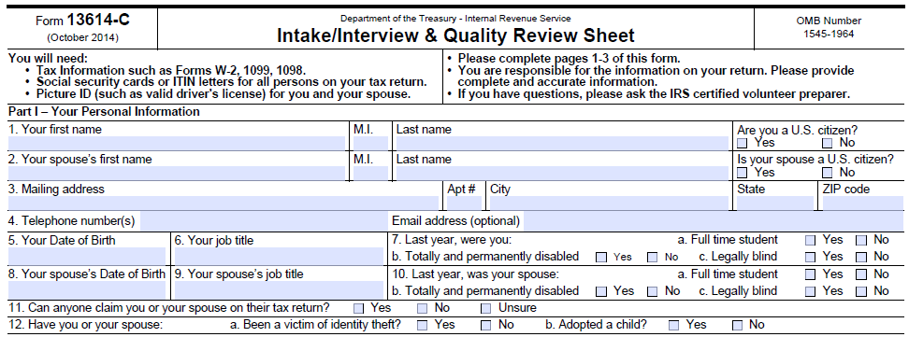
Intake/Interview Sheet Page 1 Personal Information Part I

Slide 8
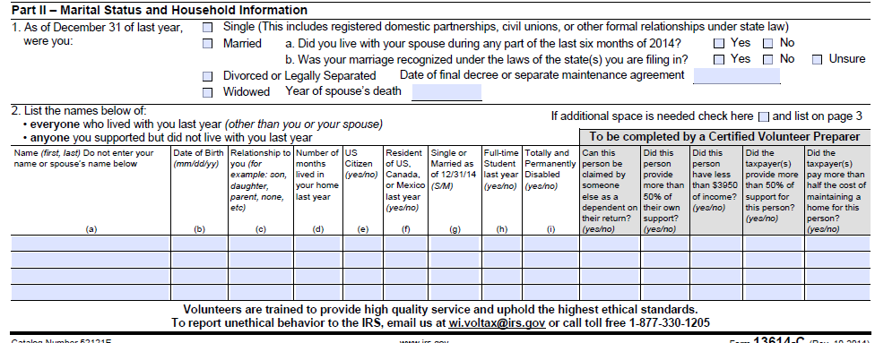
Intake/Interview Sheet Page 1 Marital & Household Information – Part II

Slide 9
Intake/Interview Sheet Page 2 Income – Part III

Slide 10
Intake/Interview Sheet Page 2 Expenses – Part IV

Slide 11
Intake/Interview Sheet Page 2 Life Events – Part V

Slide 12
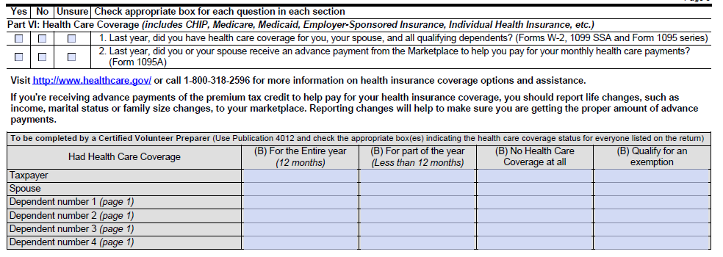
Intake/Interview Sheet Page 3 – Health Care Coverage - Part VI

Slide 13
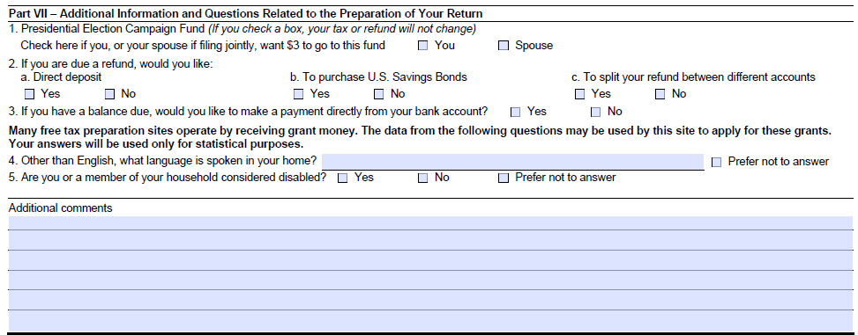
Intake/Interview Sheet Page 3 – Additional Information & Questions – Part VII

Slide 14
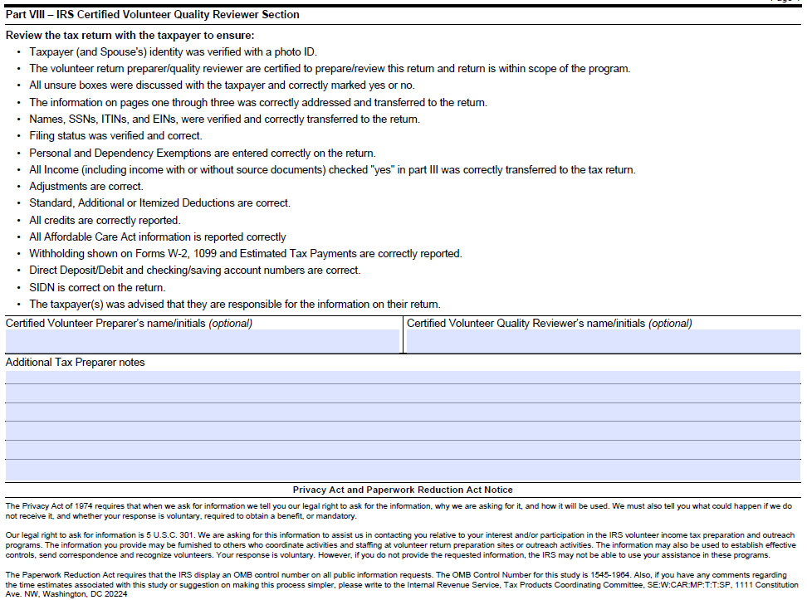
Intake/Interview Sheet Page 4

Slide 15
Counselor Confirms Information in Intake/Interview Sheet
Counselor must interview & probe with questions where necessary
Verify taxpayer identity
Review all information and checked answers; Answer all “gray” sections of Form, Update answers checked “unsure” with Yes/No
Correct Intake/Interview sheet answers, if needed
Cross reference “Yes” checked boxes to tax documents
Confirm return is in scope
Form 13614-C becomes the basis for the tax return
Continue to reference Form 13614 while completing the return

Slide 16
Effective Interviewing
Speak clearly, simply, and loud enough
Reassure the taxpayer (“I understand”)
Ask effective questions, i.e. - probing and open-ended
Use active listening skills
Allow the taxpayer time to respond
Let them explain in their own words
Paraphrase to show understanding
Don’t be afraid to say, “I don’t know – let me check”
Involve the taxpayer
Notes:
01CourseIntro 2010
16
Ask questions such as:
“Have you had any changes…”
“Tell me a little more about that”
Rather than just questions with Yes/No answers
Ask students how to build rapport. Answer: Reassure, i.e. - “I understand”
Ask students how to ask effective questions. Answer: Use Form 13614-C, probe, ask open-ended questions
Ask students, What are active listening skills? Answer: Use nonverbal cues, allow time, restate, express empathy
Ask students how to overcome communication barriers. Answer: Involve taxpayers in the process; explain

Slide 17
Probing Interview Techniques
Engage taxpayers in a conversation to clarify their answers and identify other tax issues that may affect tax return
Verify any issue that is not clear, ask more questions until you are satisfied you have all the facts. Verify and clarify information which appears to have changed from last year’s tax return
Verify that taxpayer has all needed documents
Verify accuracy of documents and receipts
Use due diligence
Notes:
17
Sometimes it’s not enough just to ask their filing status; taxpayers must be asked appropriate questions so that you are confident the filing status is correct. It may appear you are prying, but these questions are needed to file an accurate return
Refer to sample interviews in Pub 4491, Lesson 2

Slide 18
Verify Taxpayer Identity
Confirm identity of taxpayer and spouse with photo ID
Site Coordinator approval required for exemptions; should be very rare
Personal verification of ID by counselor
Confirm Social Security or other taxpayer identification numbers for all other individuals on tax return
Notes:
Be cognizant of IDENTITY THEFT!
Screening may be done initially by the client facilitator, but the trained counselor must ALSO complete this step
If taxpayer and spouse are known by counselor and identity can be verified by counselor, that is acceptable
Note: Social Security number may be same number on Medicare card followed by a letter. However it could also be spouse’s SS# if it is followed by a B.

Slide 19
Taxpayer Identification Number
Best – Social Security card or ITIN (Individual Taxpayer Identification Number) letter
Alternatives
Other documents issued by Social Security Administration such as Form SSA-1099, Social Security Administration letter, Medicare card with suffix A OR
All documents with matching name and Social Security numbers plus TaxWise carry-forward of last year’s return all match
Notes:
SSA-1099 forms will not have full Social Security #s this year—only last 4 digits. This will make verification process more difficult, especially for new clients with no carry-forward data

Slide 20
Is This Tax Return In Scope?
Be aware of allowable scope for the tax program:
AARP TaxAide Scope “What’s In, What’s Out” document (link on TaxPrep4Free.org)
NJ “Can/Cannot Do” Lists (link on TaxPrep4Free.org)
Review the following for Out-of-Scope items:
Intake/Interview & Quality Review Sheet
Tax documents
Prior year return
Interview and probe client for clarification
Notes:
The counselor’s job is not just to input the taxpayer’s documents – it is to ensure they are preparing an accurate and complete tax return for the customer
Not uncommon for taxpayers to mix multiple years of documents, so be sure you have this year’s

Slide 21
Organize & Review Taxpayer Documents
Sort taxpayer’s documents for sources of income and expenses
Verify correct tax year
Identify duplicate copies of same document
Give back non tax-related documents
Order tax documents in the order that they occur on the Form 1040
Update Intake/Interview Form if applicable
Interview and probe client for clarification
Add notes on Intake Sheet to provide explanation for Quality Reviewer
Notes:
Sort in Form 1040 order and leave in order so that QR person doesn’t have to hunt

Slide 22
Review Prior Year Tax Returns
Examine prior year return (if available)
Compare to current year documents and ask about additions / changes / possible missing items
Look for carryover items (e.g. capital loss, state tax payment)
Interview and probe client for clarification
Add notes on Intake Sheet to provide explanation for Quality Reviewer

Slide 23
Due Diligence Is…
Asking sufficient and thorough questions to ensure accuracy and completeness of tax return AND
Verifying accuracy of documents presented OR determining when to rely on, in good faith and without verification of, taxpayer’s oral/handwritten testimony AND
Ensuring a second person quality review
Notes:
23
Counselors must exercise due diligence in preparation of tax returns
IRS defines due diligence as the return preparer ensuring the correctness of oral and written representations made by the taxpayer
The preparer must make reasonable inquiries if the information furnished appears to be incorrect or incomplete

Slide 24
Due Diligence Is…
(cont’d)
Counselor must ask questions if information furnished appears to be incorrect, inconsistent, or incomplete
Counselor may not ignore information furnished to, or actually known, by him/her
Counselors must not KNOWINGLY prepare false returns!
Notes:
24
The bell cannot be unrung
If taxpayer tells counselor about income, it must be reported. For example:
Cash for self-employment work
Interest on checking account not reported on 1099-INT
If taxpayers tells counselor they’re married (even if spouse long gone), then cannot file single

Slide 25
Relying on Good Faith
Good Faith is relying on oral/ handwritten testimony from taxpayer that is ordinary, necessary and reasonable
Taxpayer has established credibility – a returning customer who has forgotten to bring a receipt
The dollar amount is insignificant
Notes:
Remind taxpayer (again) that they must be able to provide records if IRS or state asks for them

Slide 26
Taxpayer Responsibilities
Stress to taxpayer(s) that
It’s their return and they are responsible for accuracy of all data provided
They must have accurate and complete records if audited by IRS
Notes:
Starting point is generally to believe the taxpayer
But, taxpayers must understand that it is their return and that we are only helping them prepare and file it
They need to be told (sometimes more than once) that we will enter the data that they provide to us, but in the event of an audit, they will need to provide records and other information to substantiate their claims on the return

Slide 27
After the Interview: Four Options
Begin to prepare taxpayer(s) return
Advise taxpayer(s) to bring missing documents another day; set up another appointment
Hand off to another counselor if not in your “comfort zone”
Advise taxpayer that return is out of scope and why
Discuss situation with Site Coordinator/other counselors first
Return Intake/Interview form and all other documents to taxpayer
Notes:
If not comfortable with some in-scope tax situation, hand taxpayer off to more experienced counselor

